Slide 1
What’s in a description?
Mike and Jenny play outside in the sandbox. Mike is afraid of an owl that is in the tree. Jenny had a pie that she didn't want to share. That made Mike angry. Mike's soccer ball almost got struck by lightening. A cat anxiously sits in the park and stares at a unattended hot dog that someone left on a yellow bench. Mike and Jenny are enjoying playing with a volleyball in the park. Mike and Jenny are Playing pirates and their dog wants to play with the beach ball. Mike and Jenny are laughing while they play with the frisbee. 'OH NO!" shouts Mike as Jenny runs from the green snake! Jenny runs to ask mike if he can play tennis with her. Mike and Jenny are playing catch with a football while a dog watches and a hot air balloon flies past them. Jenny wants to play on the side but it's raining over there. Jenny and Mike are having a great time in the sunny park as she pitches a baseball to Mike who is waiting with his bat. Mike and Jenny are happy that it is finally time to eat! Jenny is scared of a snake at their campsite but Mike wants to go catch it. Mike was about to step into the sandbox when he saw there was snake in there. Mike went down the slide too quickly and Jenny is worried that he is hurt. Mike is sliding down the red slide and Jenny is asking him if he wants to play tennis or baseball. Nobody is playing at the park because a thunder storm started and rain came pouring down. Mike is so sad that he has to play alone. Mike is sad that the hot dogs are burning on the grill! Jenny is happy just to have the sandwich and pizza. Jenny is talking to an owl in the tree. The owl is actually a wizard that is disguised. Mike is happy to see a cat in the sandbox but Jenny doesn't like cats so she is afraid. Mike and Jenny are playing catch with a baseball but somehow Mike climbed up in a tree. Mike trips on his way to catch a frisbee. Jenny is frustrated with his incompetence. Mike and Jenny happily watch as a hat-wearing duck and a glasses-wearing owl stand under an apple tree. Jenny and Mike were happy to see each other even though it was raining. The cat comes to see Mike and Jenny while they are playing by the sandbox. Mike laughs when he sees Jenny coming with a owl on her arm! Jenny and Mike are having so much fun! They are resting after playing baseball. Mike is asking dog and cat where Jenny is. Look she is hiding behind the tree! Jenny's pie got wet. Mike was happy it was ruined since she'd refused to share it with him. Jenny bakes Mike a pie so that he will consider joining silly hats club. Mike and Jenny are happy that the dog has came back! Jenny is playing with a cat in the sandbox. Mike and Jenny sit in the grass and laugh while they watch a cat try to slide down the slide. Mike and Jenny urge the duck to fetch the bucket for them. Mike and Jenny are standing by the fire while a big brown bear tries to scare the two friends. Mike and Jenny are happy to play ball at the park! Mike jumps off the swing and runs to Jenny. Jenny has balloons to share with Mike. Mike and Jenny play outside in the sandbox. Mike is afraid of an owl that is in the tree. Jenny had a pie that she didn't want to share. That made Mike angry. Mike's soccer ball almost got struck by lightening. A cat anxiously sits in the park and stares at a unattended hot dog that someone left on a yellow bench. Mike and Jenny are enjoying playing with a volleyball in the park. Mike and Jenny are Playing pirates and their dog wants to play with the beach ball. Mike and Jenny are laughing while they play with the frisbee. 'OH NO!" shouts Mike as Jenny runs from the green snake! Jenny runs to ask mike if he can play tennis with her. Mike and Jenny are playing catch with a football while a dog watches and a hot air balloon flies past them. Jenny wants to play on the side but it's raining over there. Jenny and Mike are having a great time in the sunny park as she pitches a baseball to Mike who is waiting with his bat. Mike and Jenny are happy that it is finally time to eat! Jenny is scared of a snake at their campsite but Mike wants to go catch it. Mike was about to step into the sandbox when he saw there was snake in there. Mike went down the slide too quickly and Jenny is worried that he is hurt. Mike is sliding down the red slide and Jenny is asking him if he wants to play tennis or baseball. Nobody is playing at the park because a thunder storm started and rain came pouring down. Mike is so sad that he has to play alone. Mike is sad that the hot dogs are burning on the grill! Jenny is happy just to have the sandwich and pizza. Jenny is talking to an owl in the tree. The owl is actually a wizard that is disguised. Mike is happy to see a cat in the sandbox but Jenny doesn't like cats so she is afraid. Mike and Jenny are playing catch with a baseball but somehow Mike climbed up in a tree. Mike trips on his way to catch a frisbee. Jenny is frustrated with his incompetence. Mike and Jenny happily watch as a hat-wearing duck and a glasses-wearing owl stand under an apple tree. Jenny and Mike were happy to see each other even though it was raining. The cat comes to see Mike and Jenny while they are playing by the sandbox. Mike laughs when he sees Jenny coming with a owl on her arm! Jenny and Mike are having so much fun! They are resting after playing baseball. Mike is asking dog and cat where Jenny is. Look she is hiding behind the tree! Jenny's pie got wet. Mike was happy it was ruined since she'd refused to share it with him. Jenny bakes Mike a pie so that he will consider joining silly hats club. Mike and Jenny are happy that the dog has came back! Jenny is playing with a cat in the sandbox. Mike and Jenny sit in the grass and laugh while they watch a cat try to slide down the slide. Mike and Jenny urge the duck to fetch the bucket for them. Mike and Jenny are standing by the fire while a big brown bear tries to scare the two friends. Mike and Jenny are happy to play ball at the park! Mike jumps off the swing and runs to Jenny. Jenny has balloons to share with Mike. Mike and Jenny play outside in the sandbox. Mike is afraid of an owl that is in the tree. Jenny had a pie that she didn't want to share. That made Mike angry. Mike's soccer ball almost got struck by lightening. A cat anxiously sits in the park and stares at a unattended hot dog that someone left on a yellow bench. Mike and Jenny are enjoying playing with a volleyball in the park. Mike and Jenny are Playing pirates and their dog wants to play with the beach ball. Mike and Jenny are laughing while they play with the frisbee. 'OH NO!" shouts Mike as Jenny runs from the green snake! Jenny runs to ask mike if he can play tennis with her. Mike and Jenny are playing catch with a football while a dog watches and a hot air balloon flies past them. Jenny wants to play on the side but it's raining over there. Jenny and Mike are having a great time in the sunny park as she pitches a baseball to Mike who is waiting with his bat. Mike and Jenny are happy that it is finally time to eat! Jenny is scared of a snake at their campsite but Mike wants to go catch it. Mike was about to step into the sandbox when he saw there was snake in there. Mike went down the slide too quickly and Jenny is worried that he is hurt. Mike is sliding down the red slide and Jenny is asking him if he wants to play tennis or baseball. Nobody is playing at the park because a thunder storm started and rain came pouring down.
Larry Zitnick
Microsoft Research

Slide 2
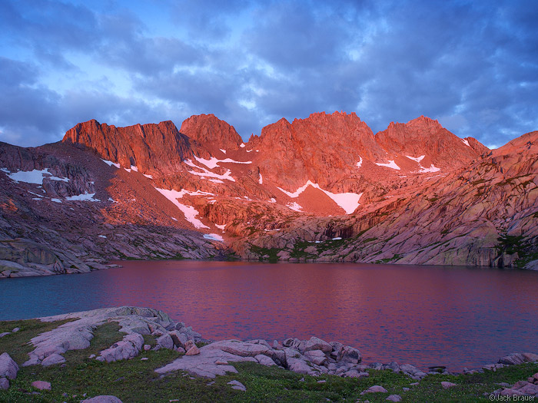
“Long, blue, spiky-edged shadows crept out across the snow-fields, while a rosy glow, at first scarce discernible, gradually deepened and suffused every mountain-top, flushing the glaciers and the harsh crags above them.” John Muir

Slide 3
Captions in the wild

Slide 4
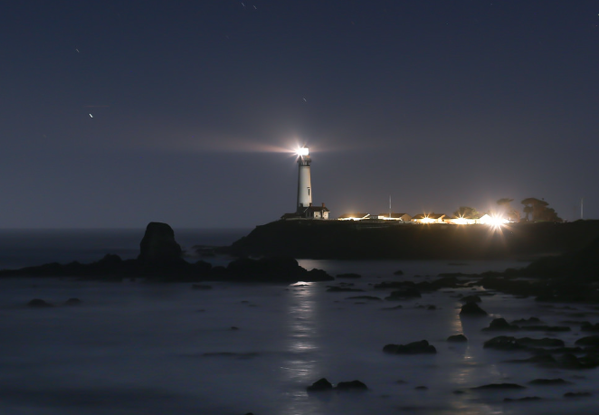
Pigeon Point Lighthouse near Pescadero, California

Slide 5
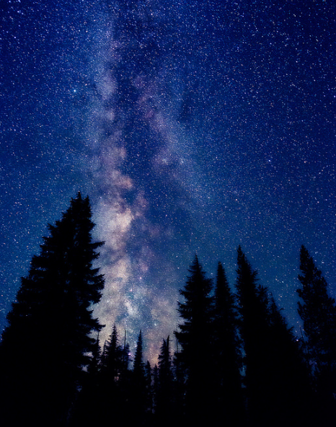
I snapped this shot right before going to sleep in my car at the South Sister trailhead Thursday night. Nothing too spectacular by most standards, but it solidifies the memory in my brain, no doubt.

Slide 6
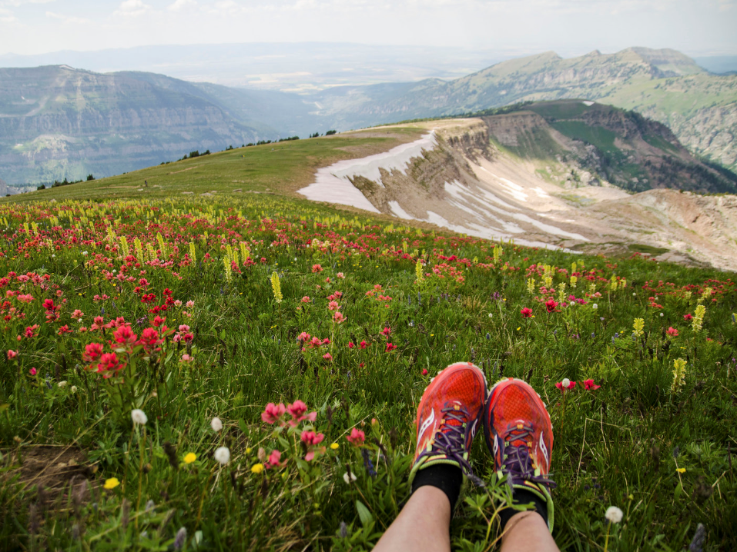
A year ago I was staring at my feet in a hospital bed after having a stroke. It was discovered that I had a hole in my heart that caused the stroke and it was quickly fixed. For my one year anniversary, I hiked Table Mountain. It's over 12 miles with an elevation gain of nearly 4000 feet. The elevation at the top is 11,300 feet. It's my favorite hike and I try and do it every year. Last year, sitting in the hospital, I only dreamed of doing this again. I can't tell you how grateful I am for my good health and a full recovery. Serendipity is the best word to describe my feelings at the moment this image was captured. Please check the comment box for an image from last year.

Slide 7
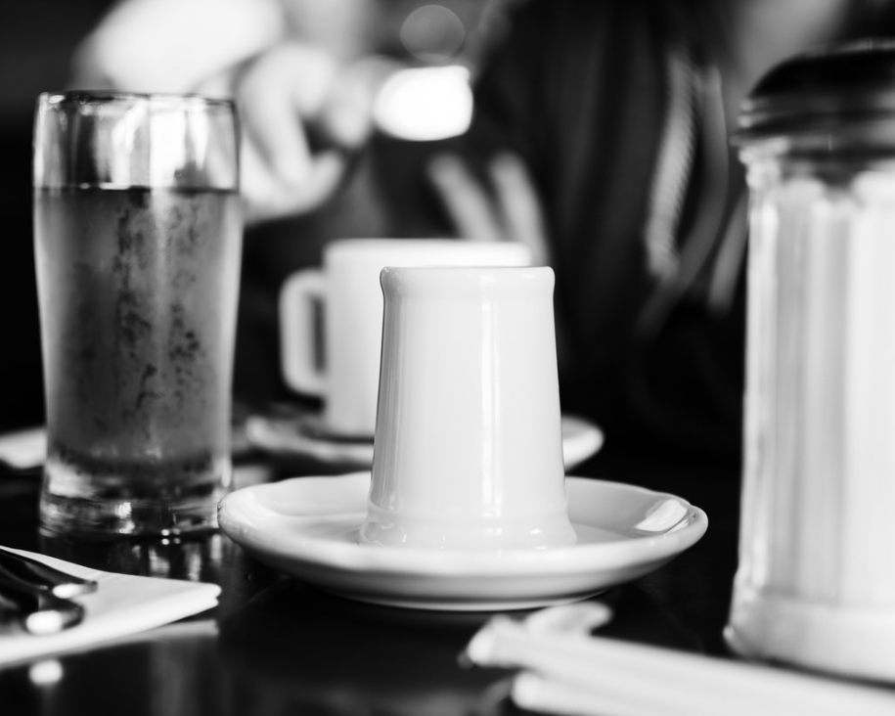
i tried to stop my 365 and found i missed is a lot, more than i really imagined i would. so i am back at it:
we all met at the Pancake house
so many delicious choices so we shared taste
getting up from the table full and happy
justin and kacy headed home
and brandon and courtney came back to the house for a bit
before leaving for Bellingham
he will leave is a bit too for the east side
leaving the dog and i here alone for a few days
to rest. . .

Slide 8
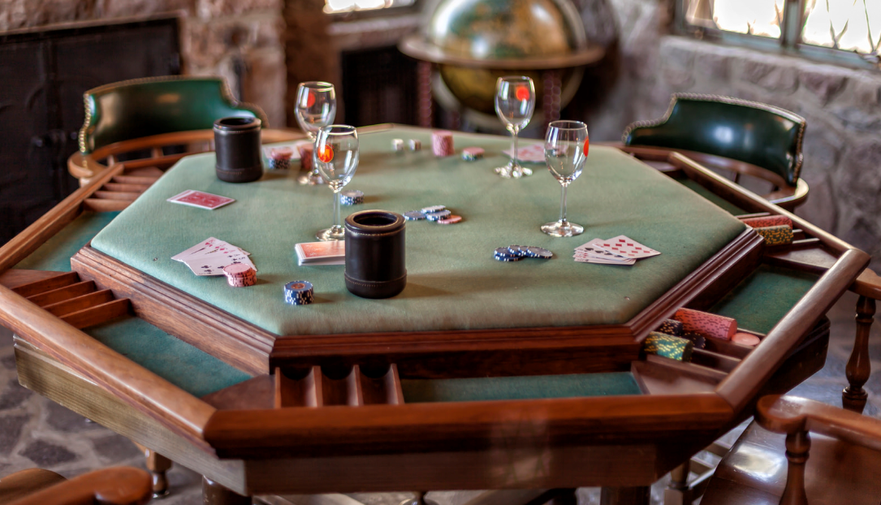
This is the private poker room, formally owned by the late George Whittle, located at the Thunderbird lodge. The lodge and property is now managed by the Thunderbird Lodge Preservation Society. George lost a large chunk of North Tahoe land to a card shark by the name of Joe King, who used the land to create the town of King's Beach, California nearly a century ago. This photo is the poker room when that famous card game was played.

Slide 9
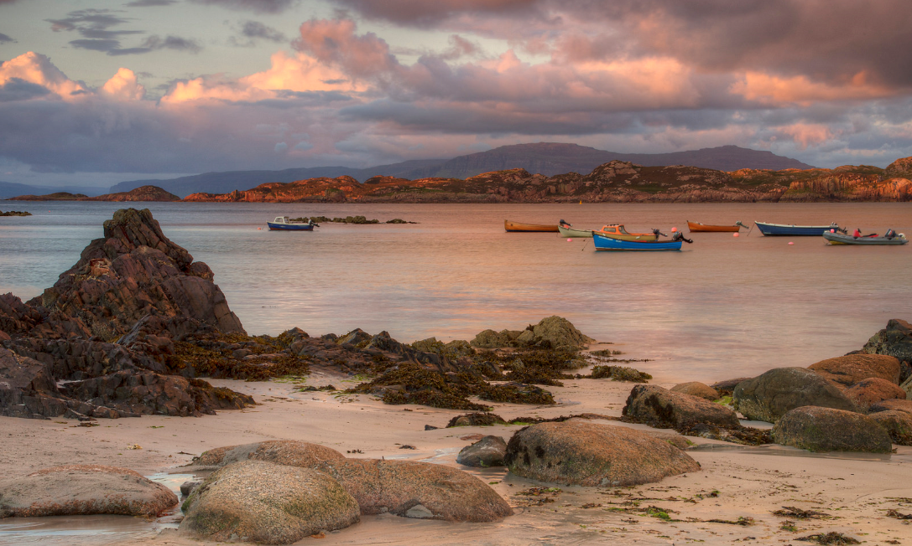
Late evening light lights up the famous pink rocks of Fionnphort and Kintra across the Sound of Iona.

Slide 10
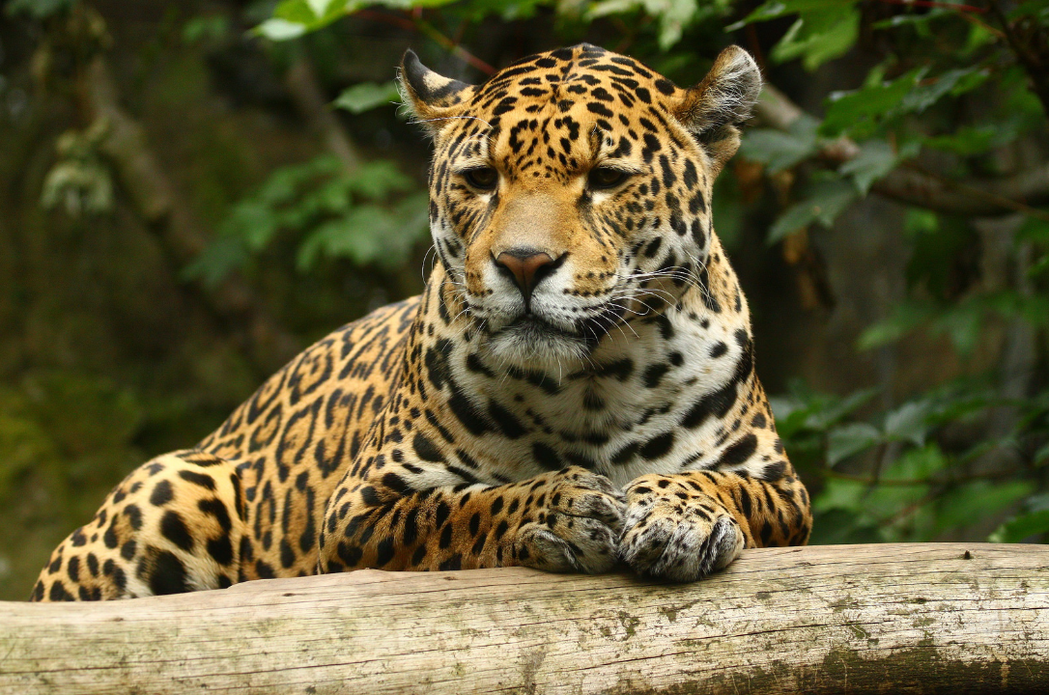
Shot was taken thru a glass window. This was the best shot without glass reflection.

Slide 11
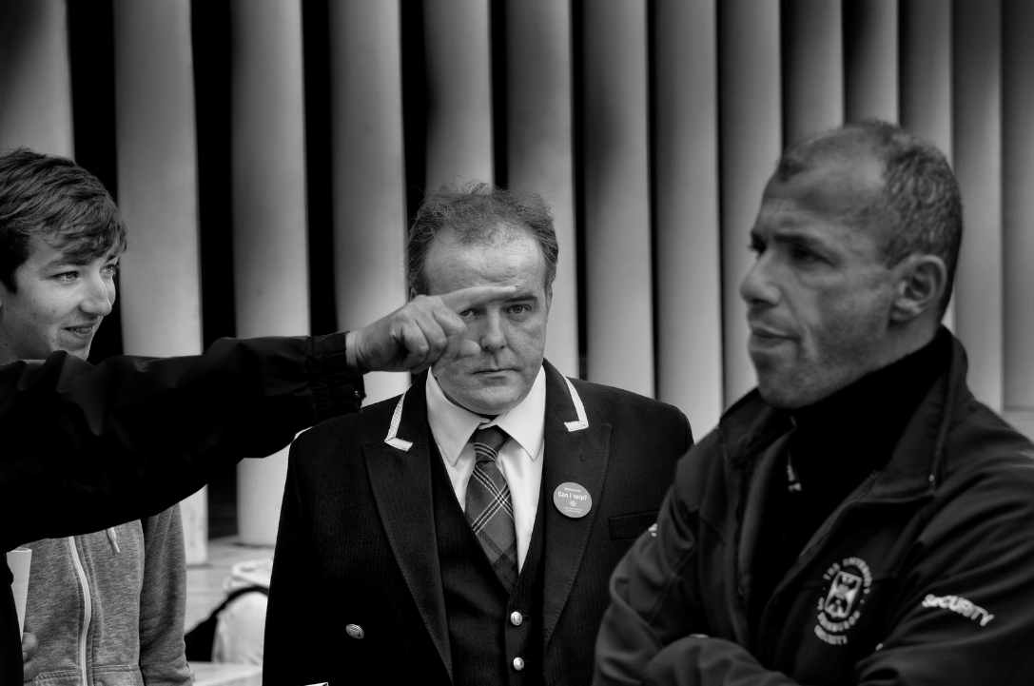
We did smile at each other after!

Slide 12
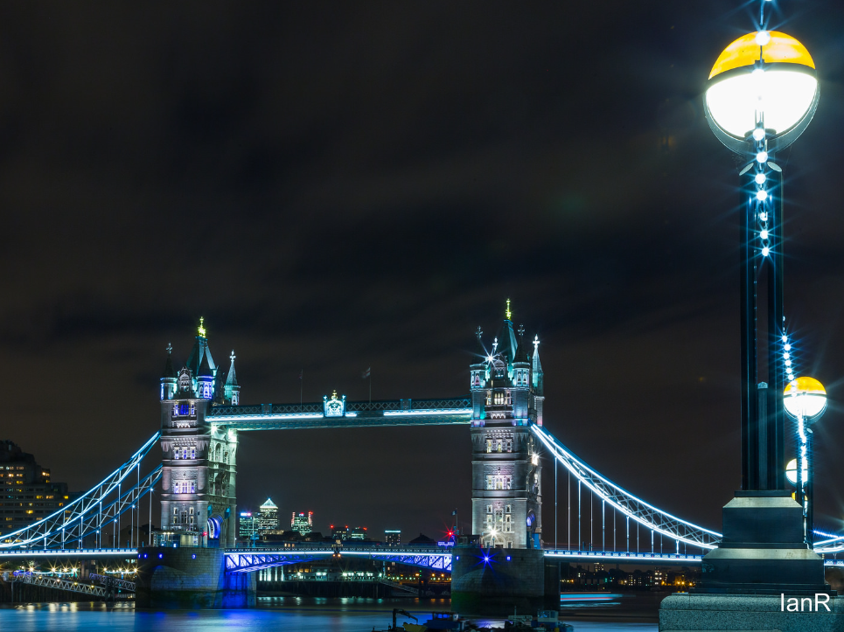
Walk up shot of Tower Bridge on an August evening

Slide 13
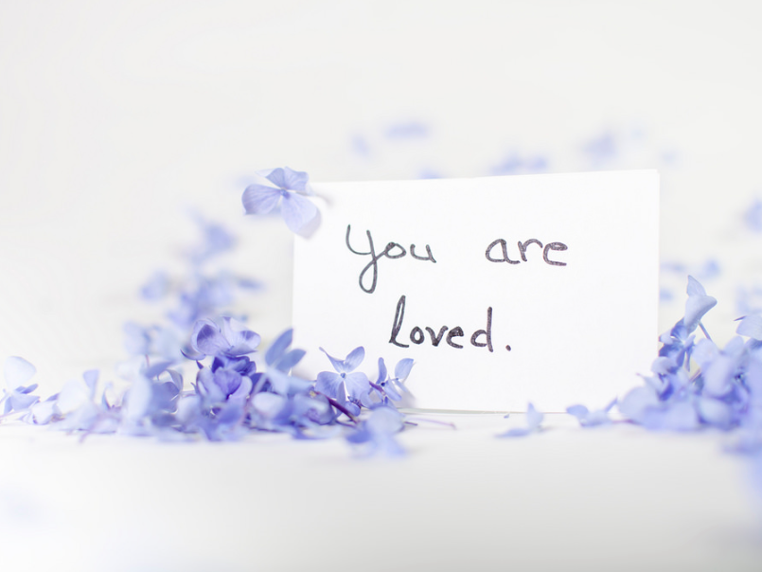
I know of a few people that could use this reminder right about now. :)

Slide 14
Captions in the wild
How the photo was taken
Proper names
Special meaning behind the photo
Events surrounding the photo

Slide 15
Describe the image using a single sentence.

Slide 16
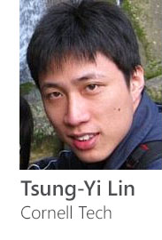
Describe the image using a single sentence.
Talk on Wednesday!
~300,000 images
5 sentences per image
Cyrus Rashtchian, Peter Young, Micah Hodosh, and Julia Hockenmaier.
Collecting Image Annotations Using Amazon's Mechanical Turk.
NAACL HLT 2010 Workshop on Creating Speech and Language Data with Amazon's Mechanical Turk.

Slide 17
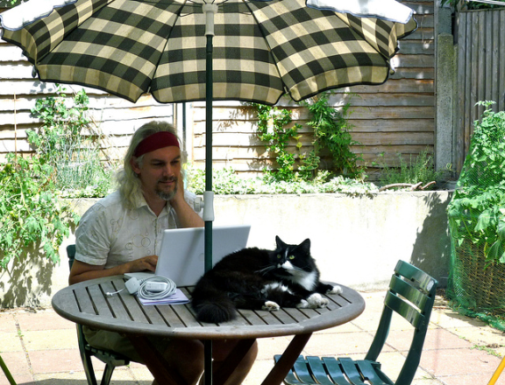
A man with a laptop and a cat on a table. A cat is sitting outside while a man works on his laptop. A hippy sitting at a table with a cat on top of it working on a laptop. A man using a laptop at a table with a cat on top of the table. A man at a table with his computer and a cat.

Slide 18
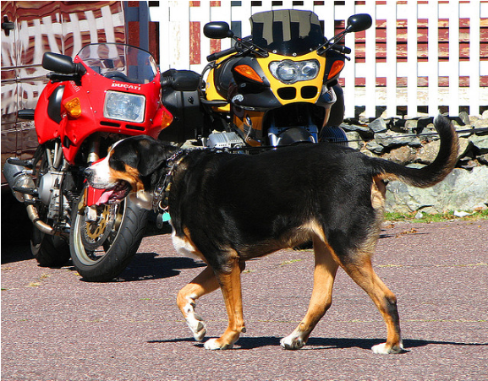
A dog trots and pants in front of two motorcycles parked in front of a fence. A brown, black and white dog walking on a street. A close up of a dog walking in front of parked motorcycles An image of a dog walking in the street A dog crossing a pavement path near motorcycles.

Slide 19
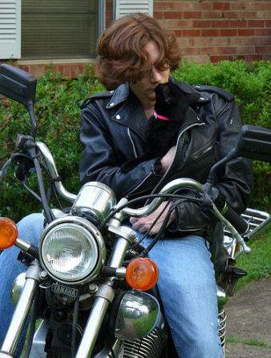
A man sits on a motorcycle holding a cat.
A motorcycle rider putting a cigarette in his mouth.
A person sitting on a motorcycle with a dog in their jacket.
Man on motorcycle holding a black cat in his jacket.
A caucasian female motorcycle rider sitting astride her motorcycle with a cat.

Slide 20
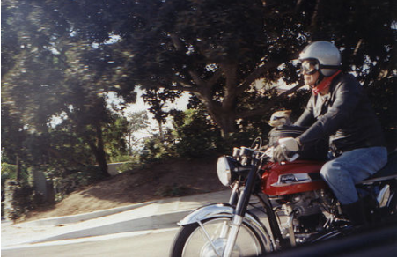
A person wearing a helmet and riding a motorcycle. A man riding a motorcycle with a small dog propped on the fuel tank. A man riding a motor cycle down a street. A person riding a motorcycle on a city street A man who is riding on a motorcycle with a cat.

Slide 21
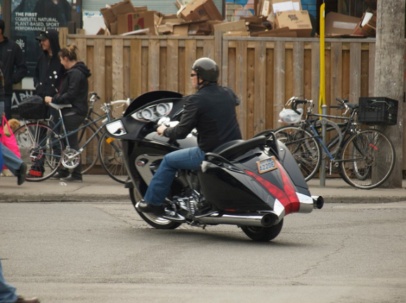
A man riding a large motorcycle near a sidewalk with bicycles. A man on a black and red motorcycle riding down the street. A man riding on the back of a motorcycle. A man with a helmet on is riding a motorcycle in the street. A man that is sitting on the back of a motorcycle.

Slide 22
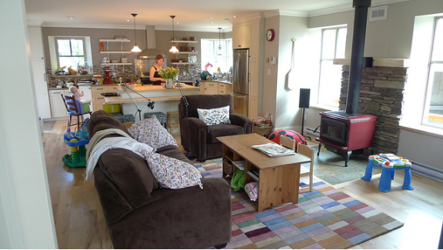
The woman is working in the kitchen with the baby in the high chair next to her.
A living room with a couch a chair and a TV.

Slide 23
A living room and kitchen with various furniture. The woman is working in the kitchen with the baby in the high chair next to her. A view of living room with brown sofas, with the kitchen in the background. A living room with a couch a chair and a tv. A woman works in a kitchen that is joined to a living room.

Slide 24
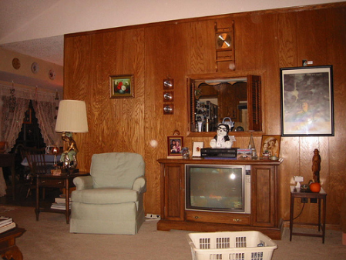
A living room with a laundry basket on the floor.
A television set a gray chair a table lamp and some pictures.

Slide 25
A room with an older model television in it. A living room with a laundry basket on the floor A living room that has a television and a chair A television set a gray chair a table lamp and some pictures A picture of a old fashioned looking living room.

Slide 26
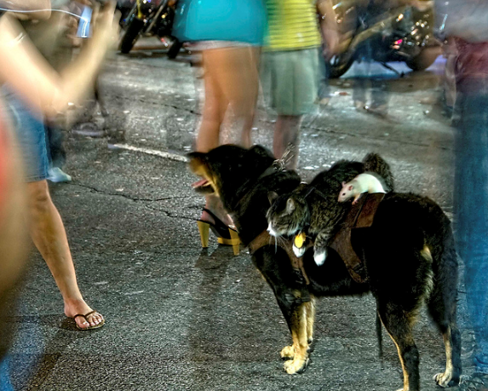
Small dog with both a cat and a mouse riding on its back.
Cat and mouse riding on a dog on a busy city street.

Slide 27
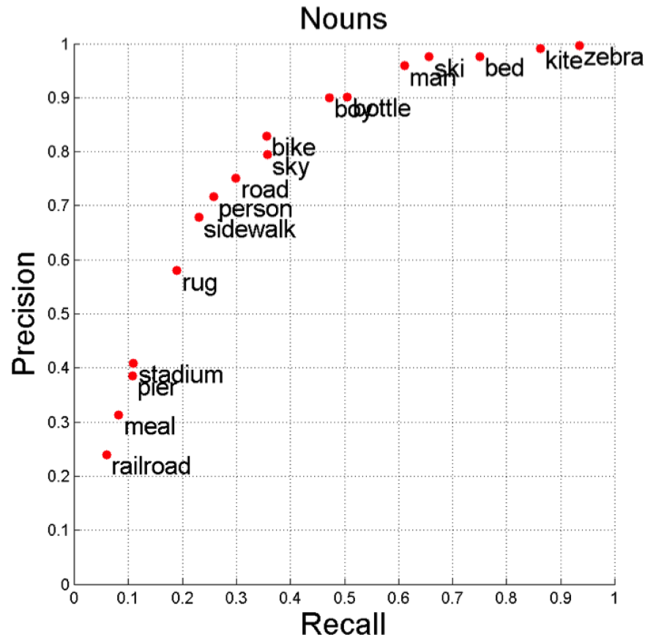
Human agreement
Saurabh Gupta, Berkeley

Slide 28
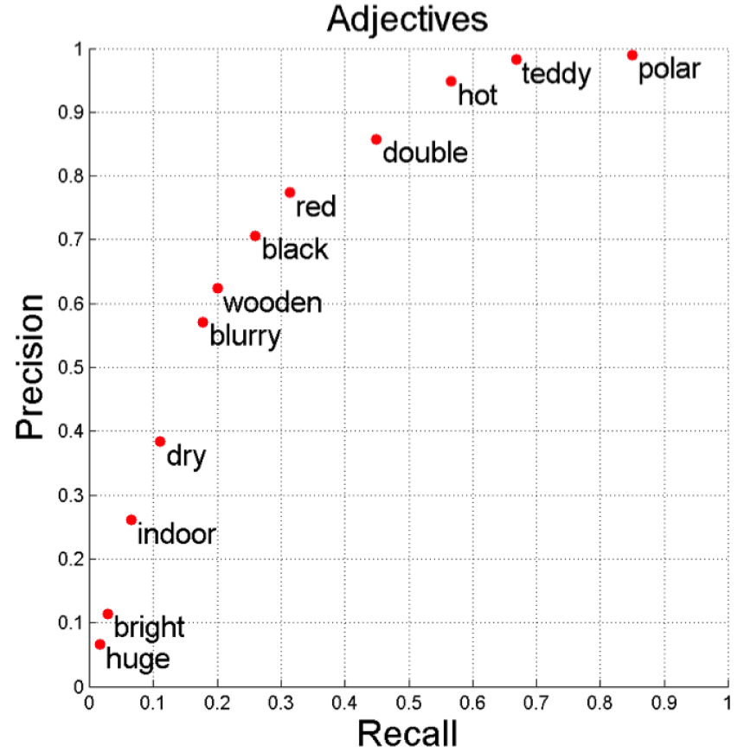
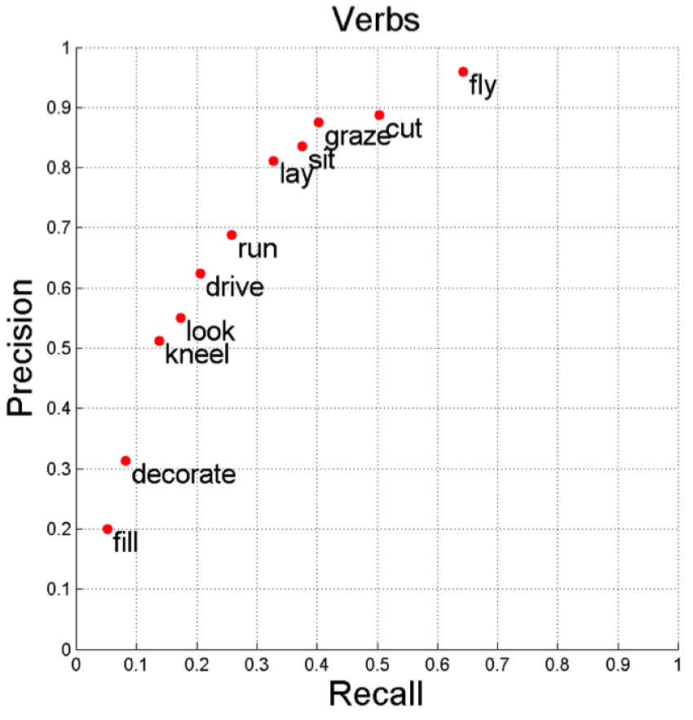
Human agreement

Slide 29
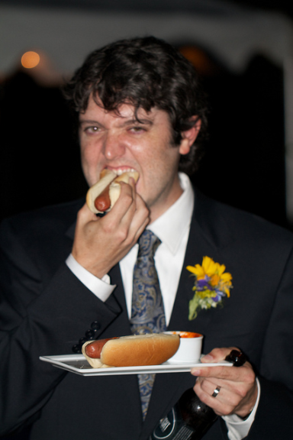
How do we evaluate?
A photo taken indoors.
A dark haired man dressed in a black suit and blue paisley tie eating a hotdog in one hand and holding a beer and plate with a hotdog in the other.
Man suit hotdog tie eat.

Slide 30
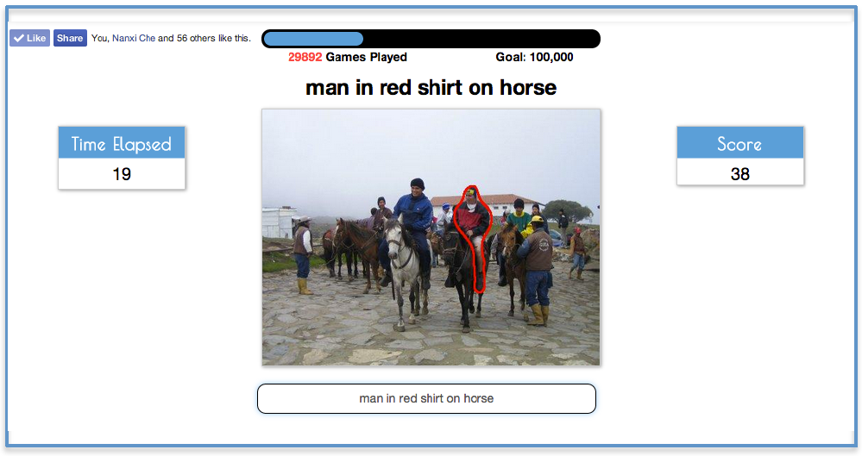
ReferItGame: Referring to Objects in Photographs of Natural Scenes
Sahar Zazemzadeh, Vicente Ordonez, Mark Matten, Tamara L. Berg,
Empirical Methods in Natural Language Processing (EMNLP) 2014.

Slide 31
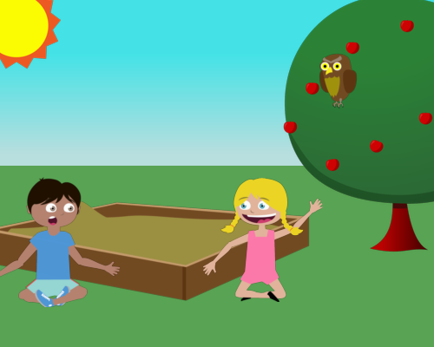
Abstract scenes

Slide 32
Write three simple sentences that describe the scene.

Slide 33
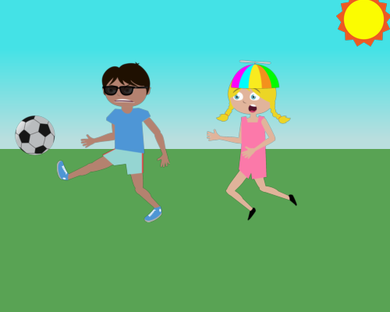
Jenny is upset because Mike isn't sharing the soccer ball.
Mike is wearing sunglasses.
Jenny is wearing a silly hat.

Slide 34
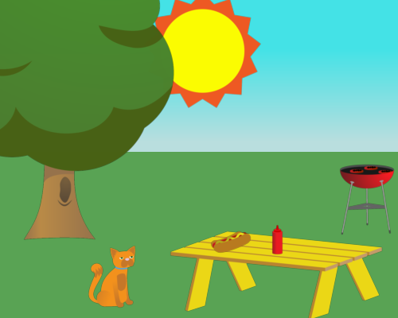
There is a hot dog on the table.
The cat looks at the hot dog.
There's food on the grill.

Slide 35
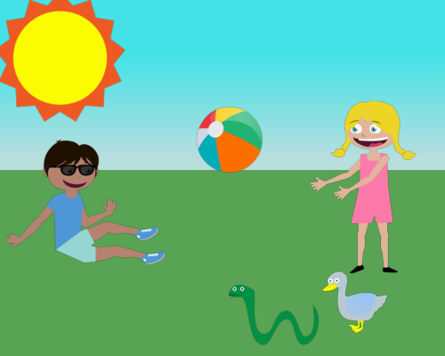
Mike and Jenny are playing with the beach ball.
Mike is wearing sunglasses.
The snake and the duck are watching.

Slide 36
Goal
?
Jenny is catching the ball.
Mike is kicking the ball.
The table is next to the tree.
Learning the Visual Interpretation of Sentences,
Zitnick, Parikh, and Vanderwende, ICCV 2013.

Slide 37
Semantics
<primary object> <relation> <secondary object>
Jenny is catching the ball.
Mike is kicking the ball.
The table is next to the tree.
<Jenny> <catch> <ball>
<Mike> <kick> <ball>
<table> <next to> <tree>
Jenny and Mike are running from the snake.
<Jenny> <run from> <snake>
<Mike> <run from> <snake>

Slide 38
Relations
run away from
hold
want
chase
throw
watch
run towards
wear
scare
run to
to
laugh

Slide 39
Qualitative results

Slide 40
Simple sentence = easy to parse
More sentences = more details

Slide 41
Describe a scene for a children’s story book.

Slide 42
Jenny loves to play soccer but she is worried that Mike will kick the ball too hard.

Slide 43
A cat anxiously sits in the park and stares at a unattended hot dog that someone left on a yellow bench.

Slide 44
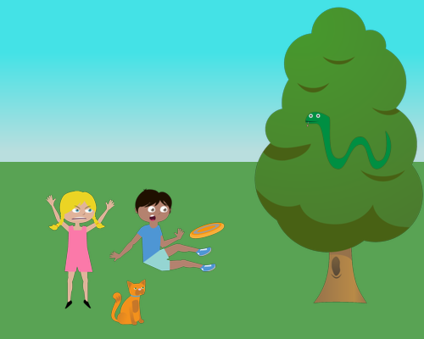
Mike trips on his way to catch a frisbee. Jenny is frustrated with his incompetence.

Slide 45
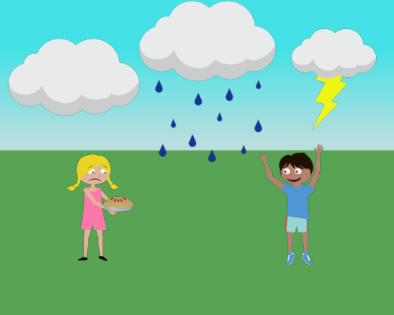
Jenny's pie got wet. Mike was happy it was ruined since she'd refused to share it with him.

Slide 46
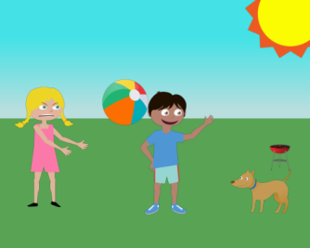
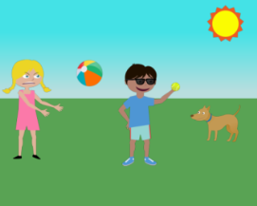
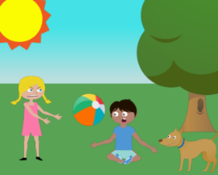
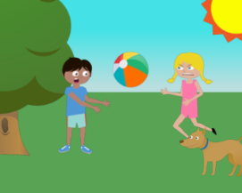
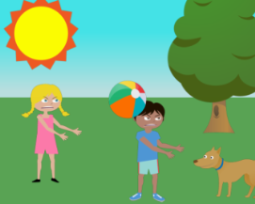
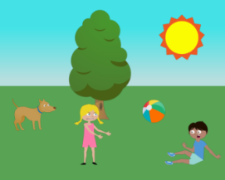
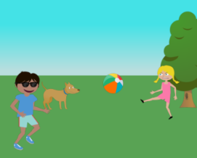
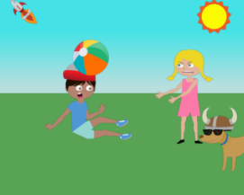
Generating data
“Jenny just threw the beach ball angrily at Mike while the dog watches them both.”
Bringing Semantics Into Focus Using Visual Abstraction, Zitnick and Parikh, CVPR 2013

Slide 47
Mike fights off a bear by giving him a hotdog while jenny runs away.

Slide 48
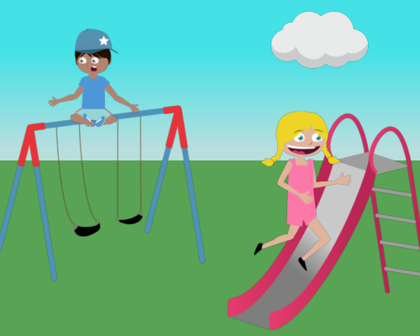
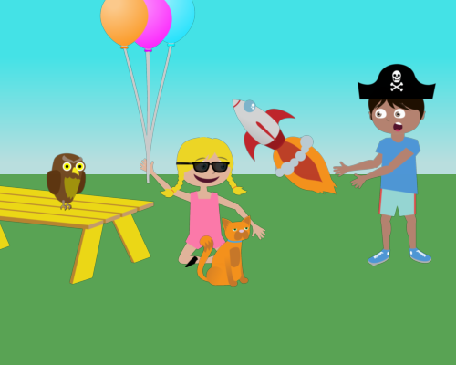
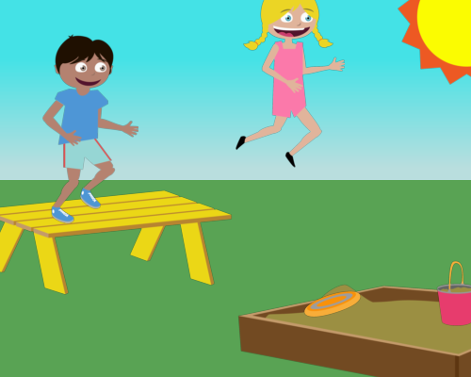
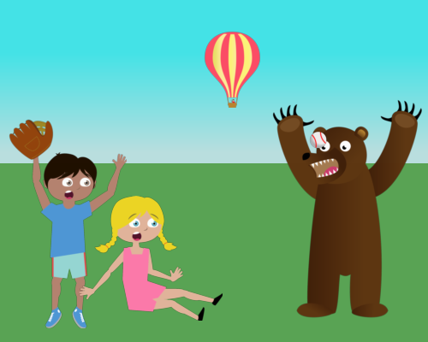
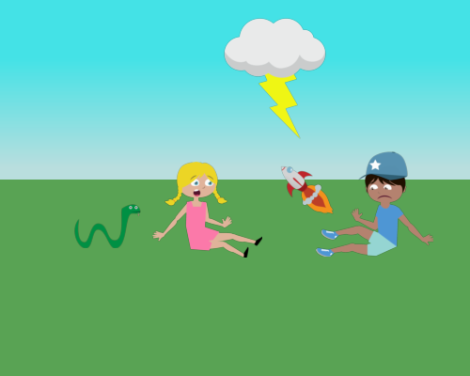
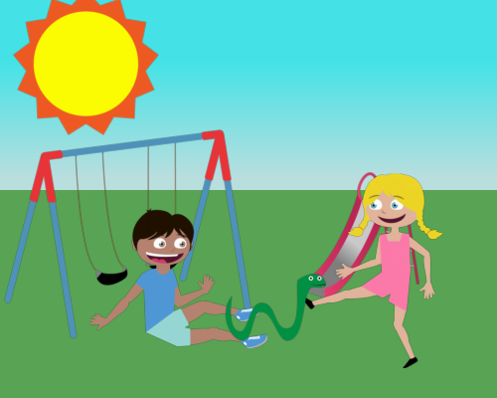
Jenny and Mike are both playing dangerously in the park.

Slide 49
It was raining in the park and a duck and a snake were trying to take shelter.

Slide 50
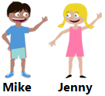
Jenny and Mike are familiar = more stories
Simple visuals ≠ simple description

Slide 51
Vision
Language
Representation
Commonsense

Slide 52
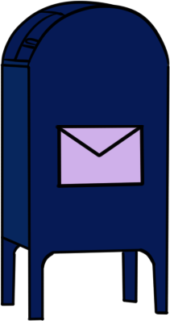
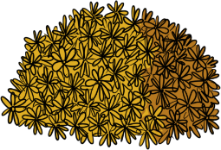
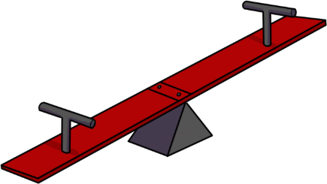
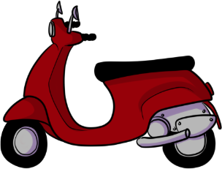

Slide 55
Xinlei Chen, CMU

Slide 56
Semantics
CV
AI

